Slide 1
Vulcan Defect Status
Dec. 28, 2015
Tao Wu, Wen Yi Gao

Slide 2
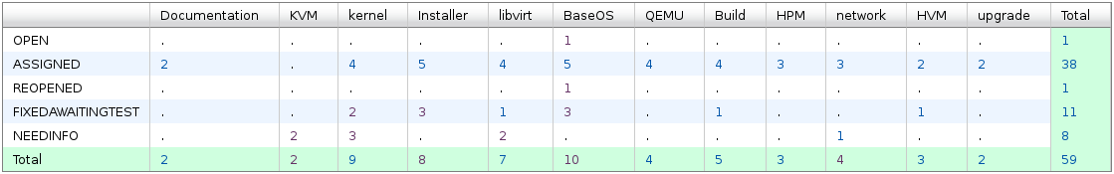
Vulcan - Open Defects
59 open defects including 11 defects in Fix-Awaiting-Test. No blocking defects for Vulcan.
20 defects new opened in the last two weeks. We solved 11 defects in the past two weeks.
Defect statistics:

Slide 3
Vulcan – High Priority Defects
Ship issue:
  Bug 126365 - Default Network Performance is less than half of line speed
    Code update *may* be completed by mid January,
    Not seem likely to be *tested* by mid January.
  Bug 134081 - Concurrent Migrations >=45 Fail to Vulcan RC1 with: error: End of file while reading data: Ncat: Invalid argument.: Input/output error
    Being under investigation.
    Log files are required by JASON.
  Bug 134365 - SLES 12 SP1 ECKD install fails
    Under investigation.

Slide 4
Vulcan – All Defects
312 defects opened in the Vulcan Bugzilla until now

